Slide 1


SWAT+ Toolbox
Workshop
Celray James CHAWANDA
celray.chawanda@tamu.edu

Slide 2
Outline
What is SWAT+ Toolbox?
Requirements
Installation
Getting Started
Create a new project
Editor Integration
Projects
Open existing projects
Add Data
Run Settings
Parameters
Run
Sensitivity analysis
Observations
Manual Calibration
More
Management
Automatic Calibration
Model Checks

Slide 3


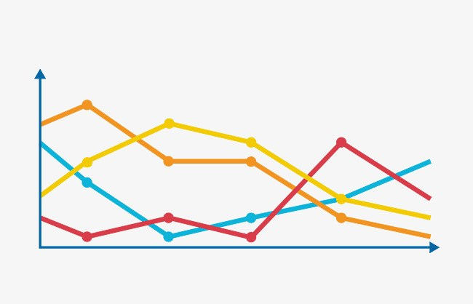




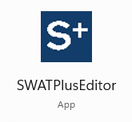
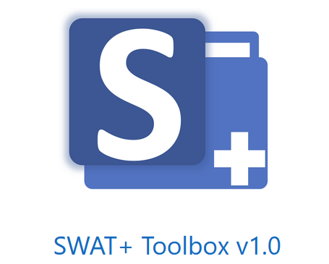
What is SWAT+ Toolbox?
Sensitivity Analysis
Calibration
Extraction
QSWAT+
Model Check
SWAT+ Toolbox is a free tool for adapting SWAT+ Model
Management

Slide 4



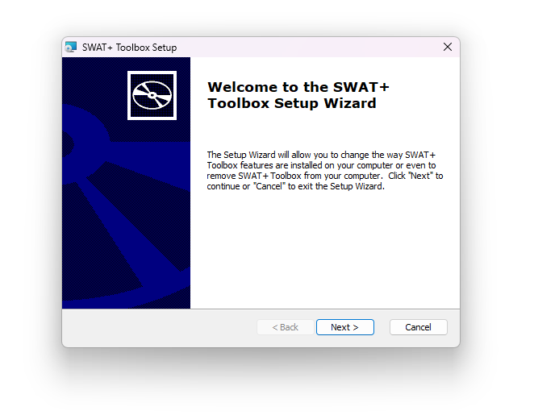

Getting Started
Requirements & Installation
Windows
1080p Screen resolution minimum
i5, 8GB RAM Recommended
Download from the SWAT Website
Double-Click
to install
https://celray.github.io/SWATPlusToolbox/downloads/

Slide 5
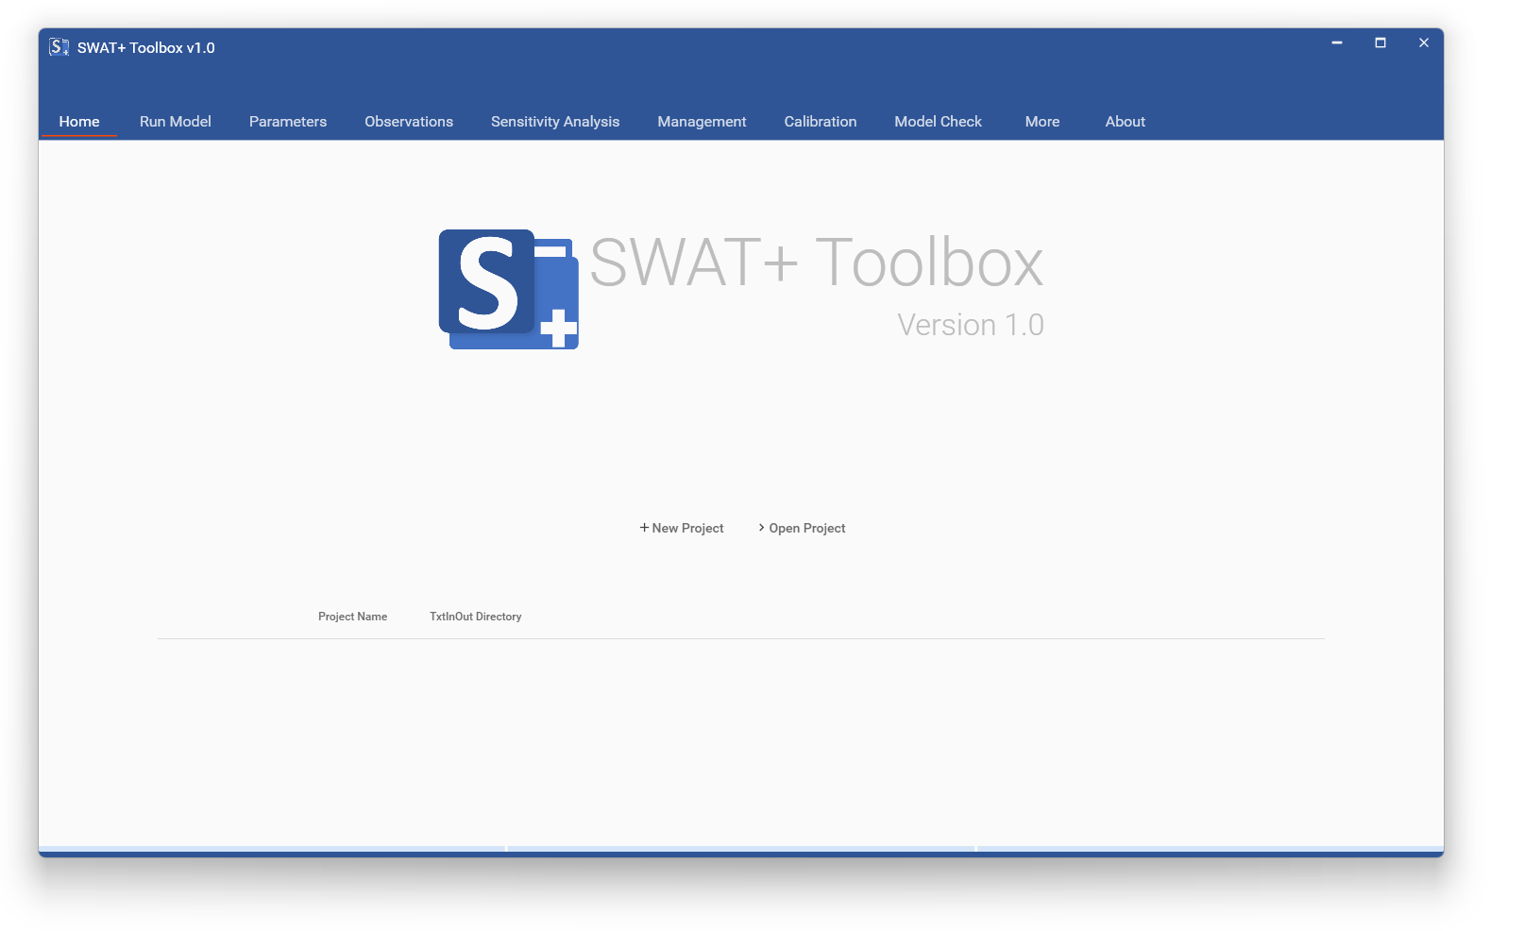
Getting Started
Requirements & Installation

Slide 6

Getting Started
QSWAT+ Integration
Aimed at creating/opening projects easily
Separate Patch is stopped

Slide 7
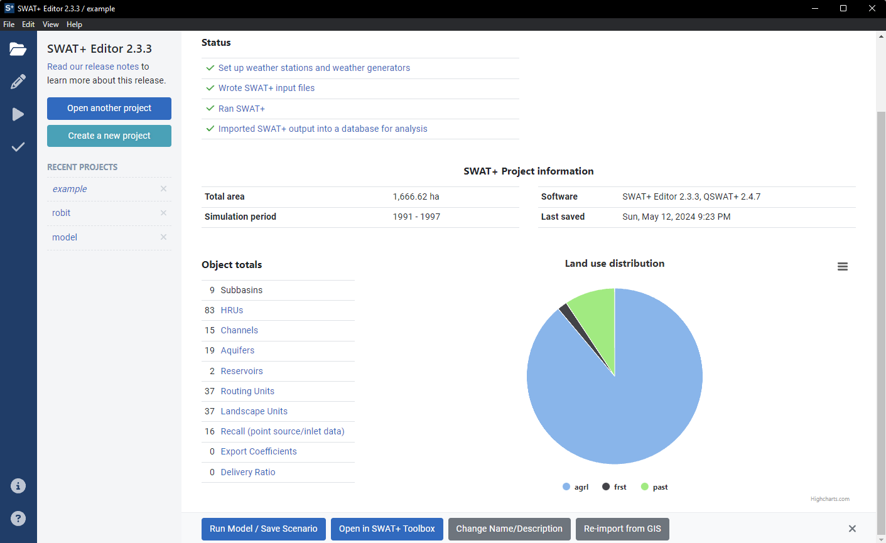


Projects
Creating a new Project
You can create from SWAT+ Editor
From the SWAT+ Toolbox Home Page

Slide 8
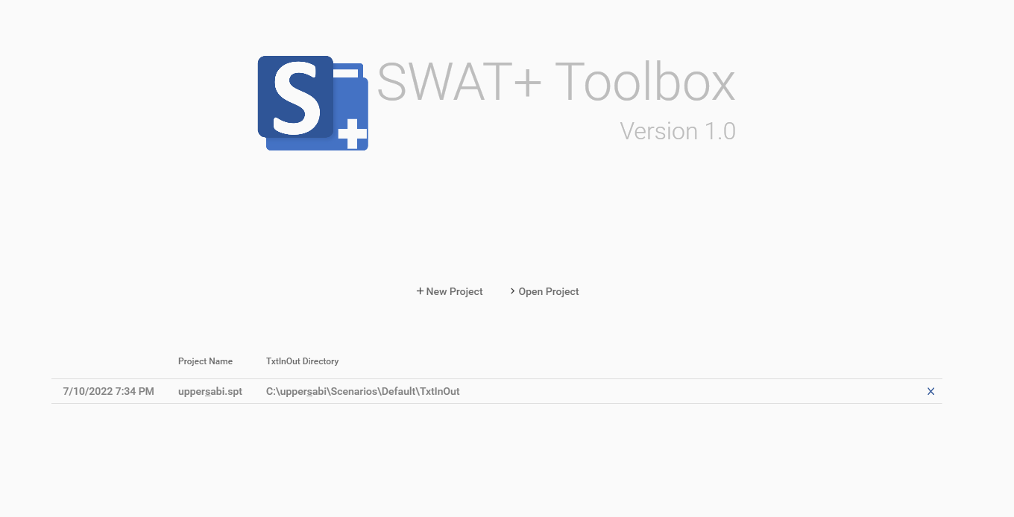
Projects
Opening an existing project
Recent
Projects
Open
Button
SWAT+ Editor
Integration

Slide 9
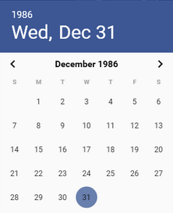
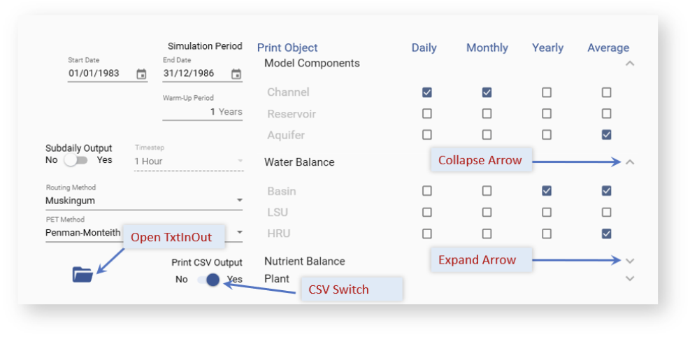

Add data to your project
Run Settings
The settings used here will be used through out
The icon → into your TxtInOut directory

Slide 10
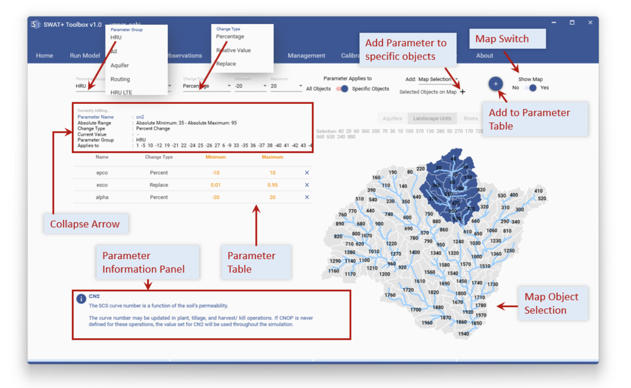
Add data to your project
Parameters
Watch the change type of your parameters
Map works QSWAT+ project is present

Slide 11
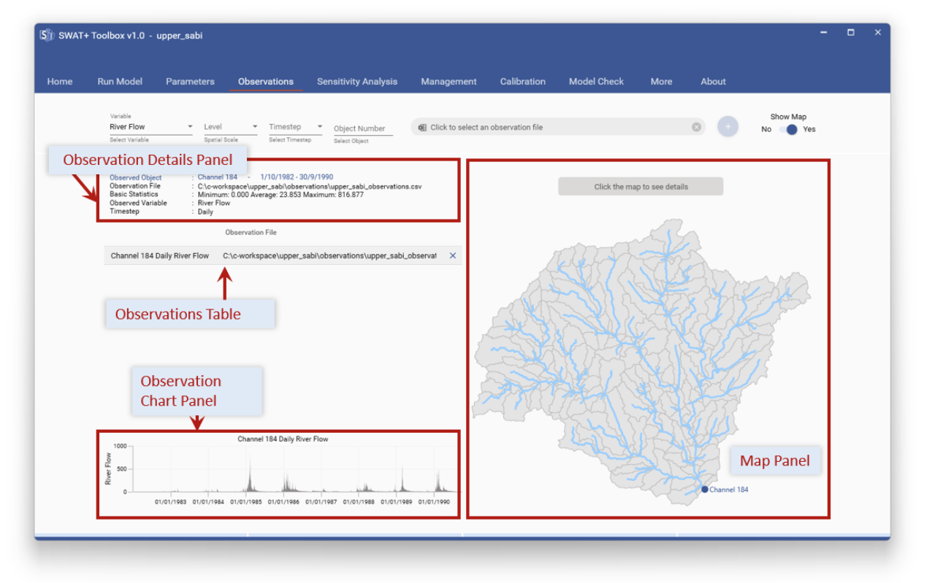
Add data to your project
Observations
Date should be dd/mm/yyyy
Missing Data should be -99 or -999

Slide 12
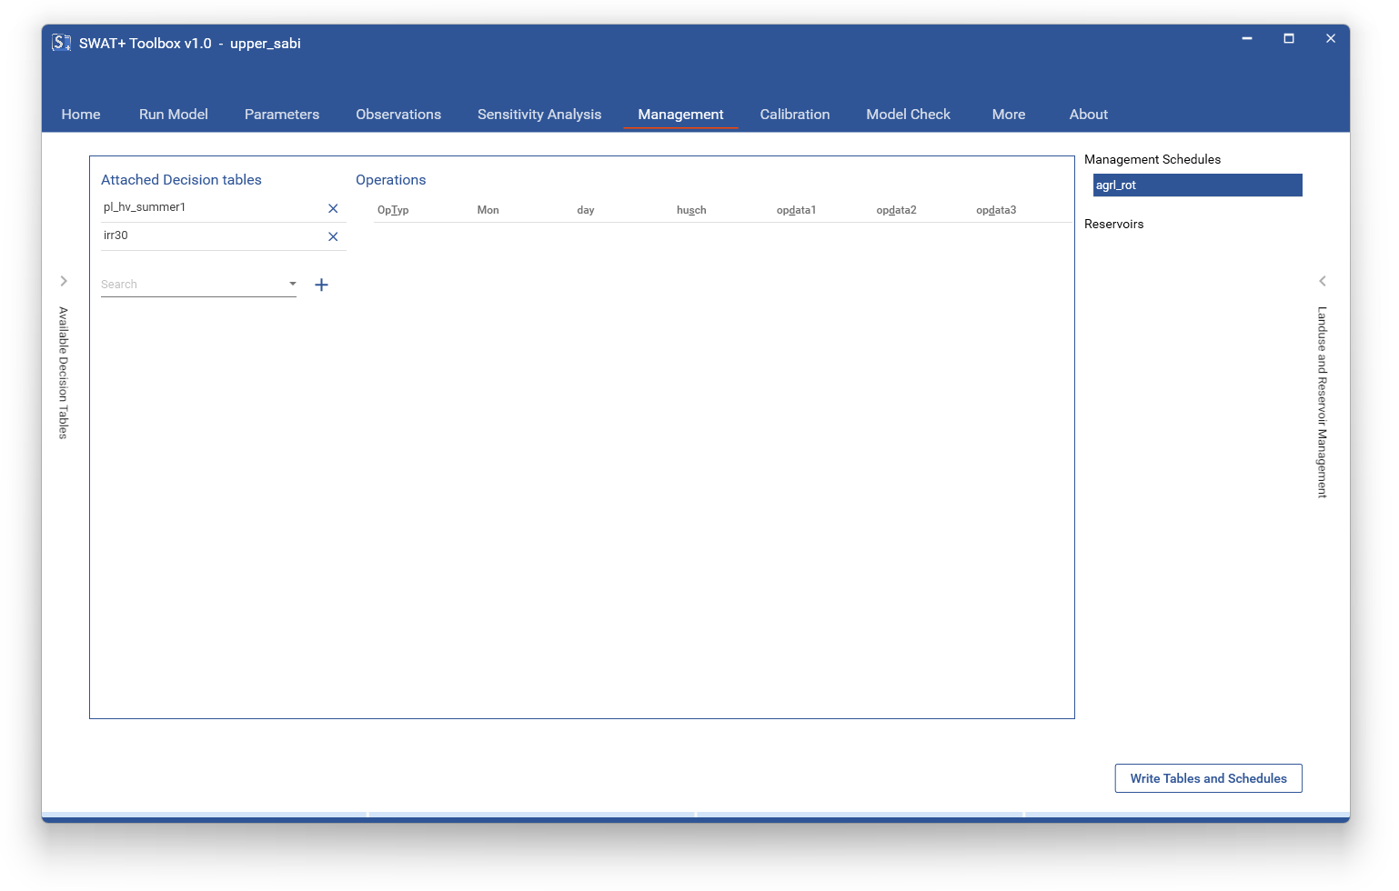
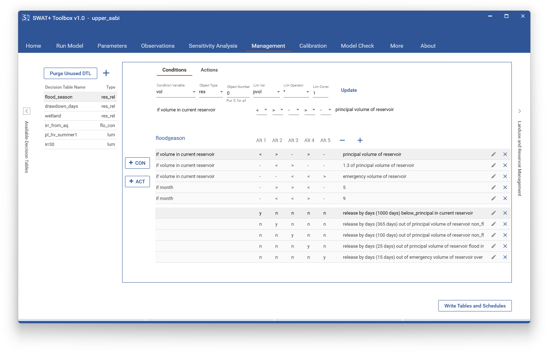
Add data to your project
Management
Define/Modify Decision Tables
Attach to existing Management Schedules

Slide 13
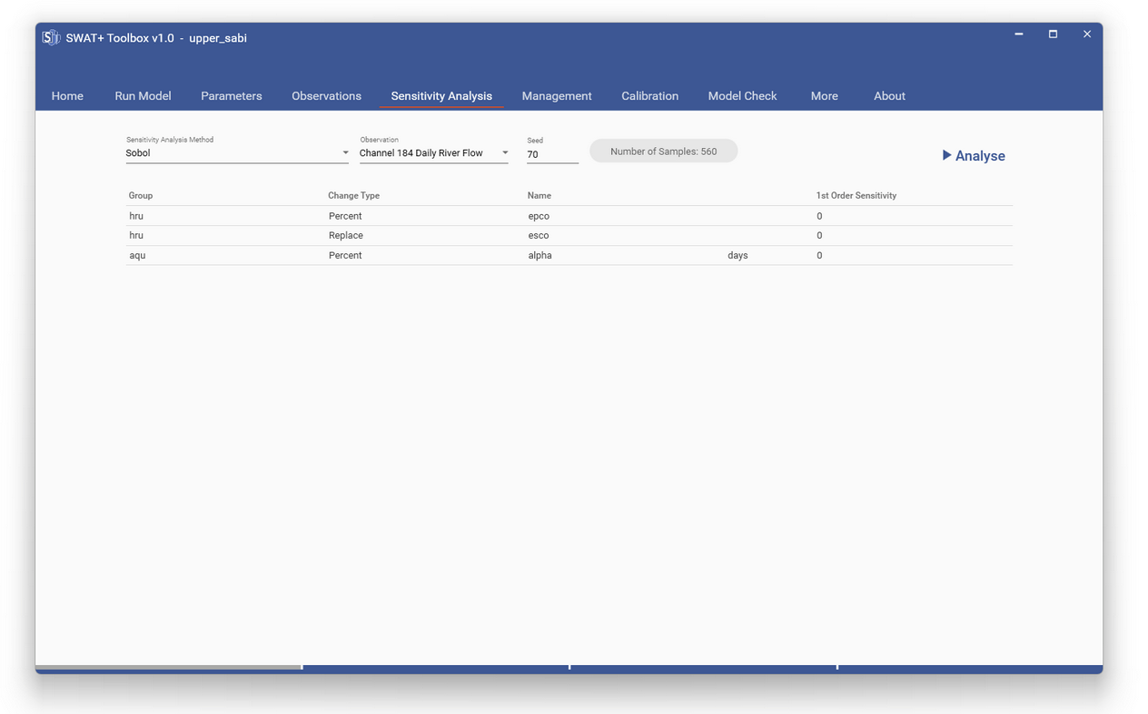
Run
Sensitivity Analysis
There are five options
Sobol
Fourier Amplitude
Random Balance Designs Fourier Amplitude
Delta Moment-independent Measure
LH-OAT

Slide 14
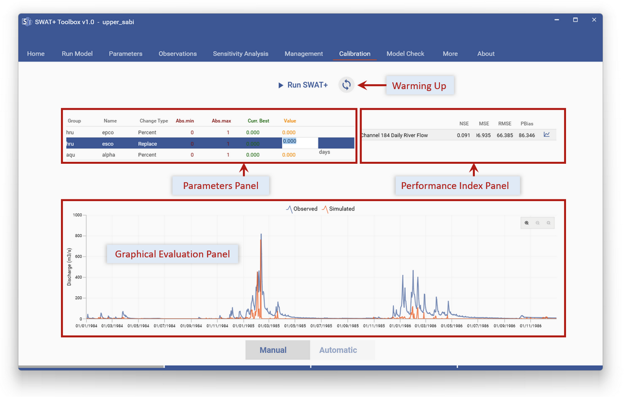
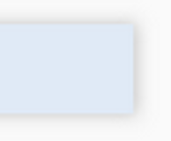
Run
Manual Calibration
Refresh Performance
Change Parameters
Run SWAT+
Evaluate

Slide 15
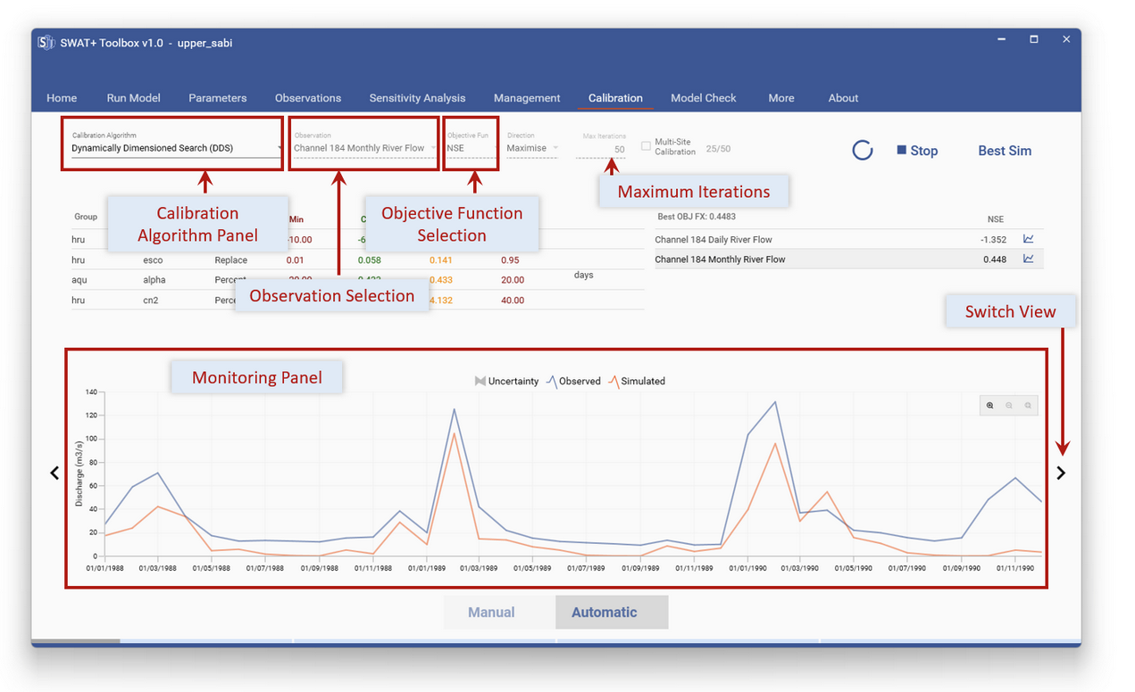
Run
Automatic Calibration
Three Algorithms Available
CALSI
DREAM
DDS
All with Parallel Processing
Minor changes to the interface

Slide 16
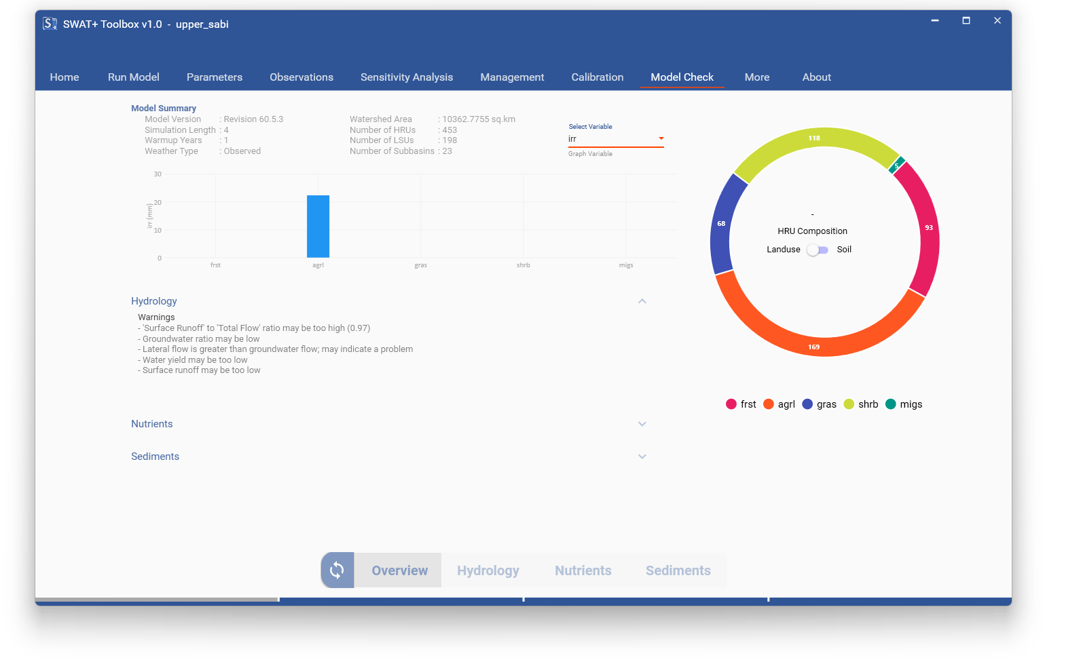
Run
Model Checks

Slide 17
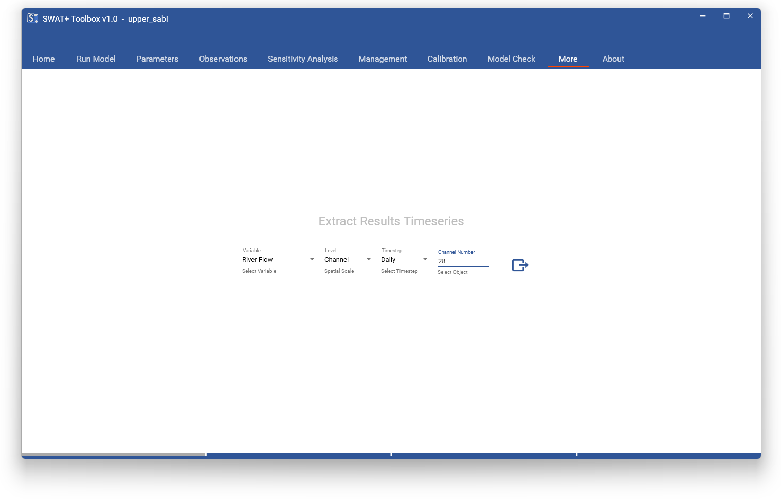
More
Extra Functionalities
Section for Extras
Currently, with ability to extract Time Series
More through Updates

Slide 18

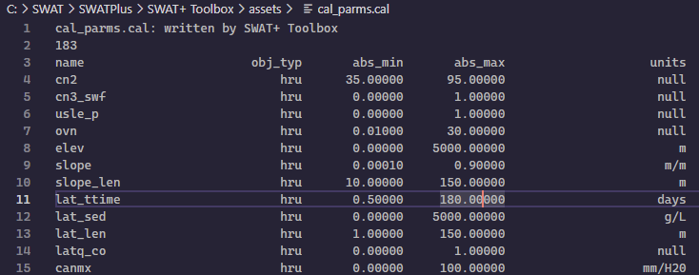
More
Custom Behaviours
Add or remove available parameters by modifying the cal_parms.cal file
"C:\SWAT\SWATPlus\SWAT+ Toolbox\assets\cal_parms.cal"

Slide 19
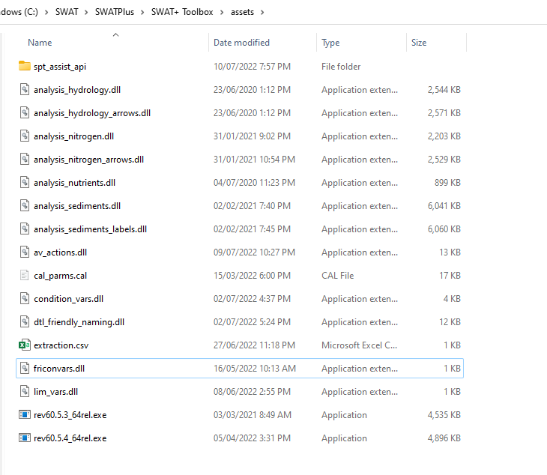
More
Custom Behaviours
Add custom executables by pasting in assets
The executable should have the name format ‘revXX.X.X_64rel.exe’

Slide 20

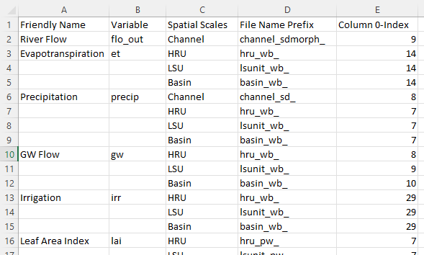
More
Custom Behaviours
"C:\SWAT\SWATPlus\SWAT+ Toolbox\assets\extraction.csv"
Add/change available output variables by modifying extraction file

Slide 21
SWAT+ Toolbox
Workshop
Celray James CHAWANDA
celray.chawanda@tamu.edu

Slide 22
Discussion

